Slide 1
Lecture 02: Docker Containers
National University of Computer & Emerging Sciences
Lecture 02 Docker Containers

Slide 2
Virtualization
Lecture 02: Docker Containers
From a computing perspective, you might have already done some virtualization if you’ve ever partitioned a hard disk drive into more than one “virtual” drive.
What other virtualized resources you have already used?

Slide 3
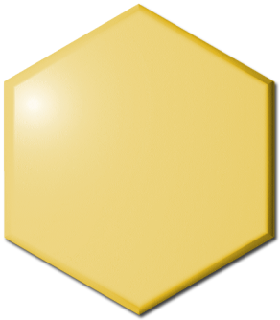

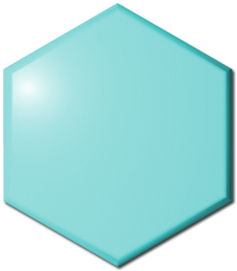

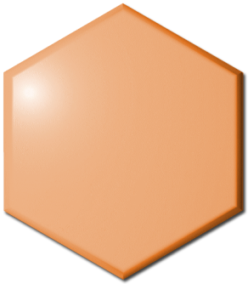

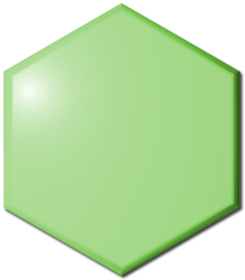

Lecture 02: Docker Containers
Virtualization Comes in Many Forms
Virtual Memory
Each application sees its own logical
memory, independent of physical memory
Virtual Networks
Each application sees its own logical
network, independent of physical network
Virtual Servers
Each application sees its own logical
server, independent of physical servers
Virtual Storage
Each application sees its own logical
storage, independent of physical storage

Slide 4
Virtual Machines

Slide 5
Question
Can a “small” operating system simulate the hardware of some machine so that
Another operating system can run in that simulated hardware?
More than one instance of that operating system run on the same hardware at the same time?
More than one different operating system can share the same hardware at the same time?
Answer: Yes

Slide 6
Solution – Virtual Machine
A virtual machine provides interface identical to underlying bare hardware
I.e., all devices, interrupts, memory, page tables, etc.
Virtual Machine Operating System creates illusion of multiple processors
Each capable of executing independently
No sharing, except via network protocols

Slide 7
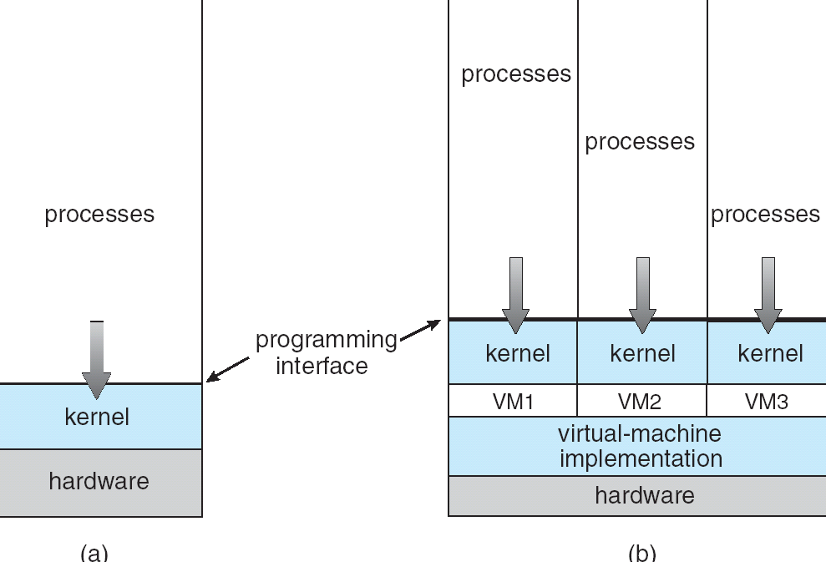
Virtual Machines (Cont)
(a) Nonvirtual machine (b) virtual machine
Non-virtual Machine
Virtual Machine

Slide 8
Java Virtual Machine
Compiled Java programs are platform-neutral byte-codes executed by a Java Virtual Machine (JVM)
JVM consists of
Class loader
Class verifier
Runtime interpreter
Just-In-Time (JIT) compilers increase performance

Slide 9
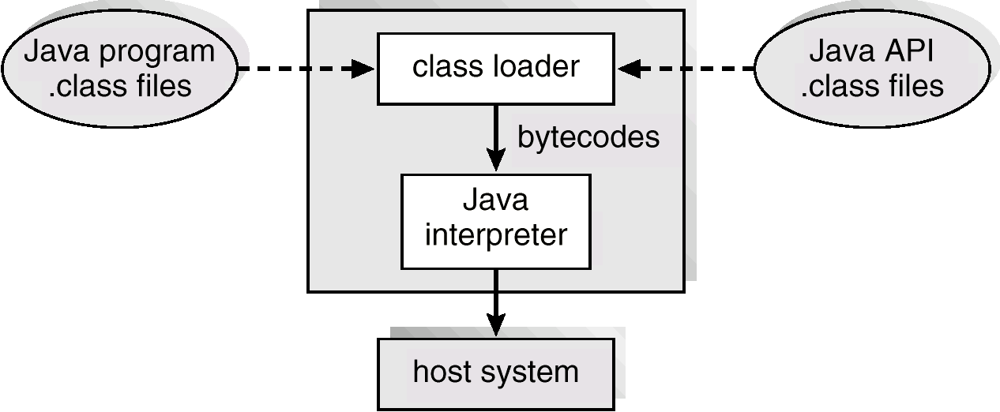
The Java Virtual Machine

Slide 10
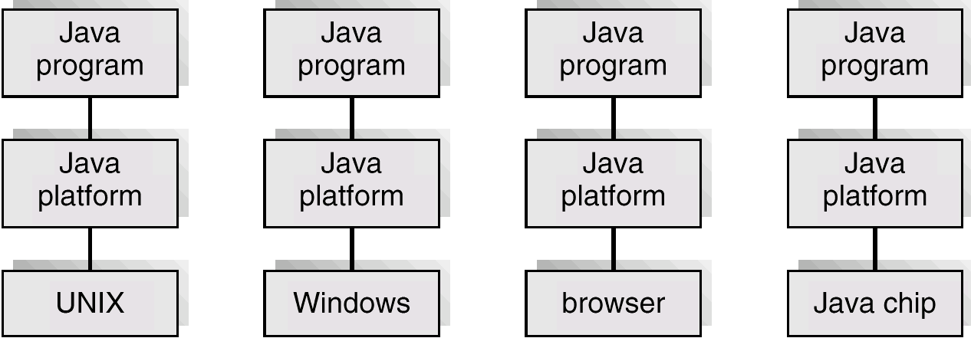
The Java Platform

Slide 11
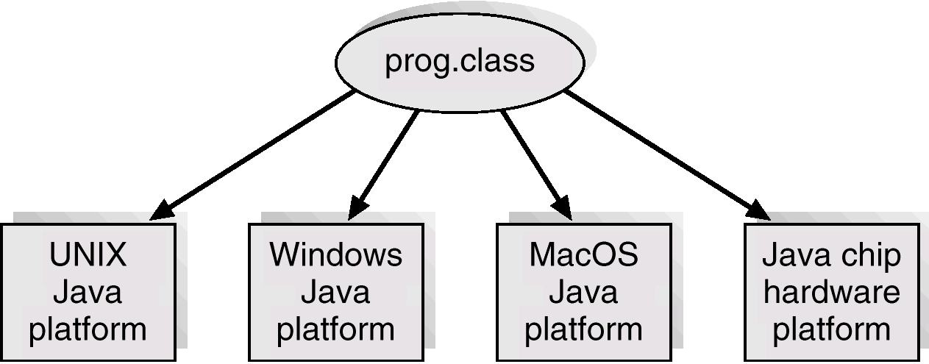
Java .class File on Cross Platforms

Slide 12
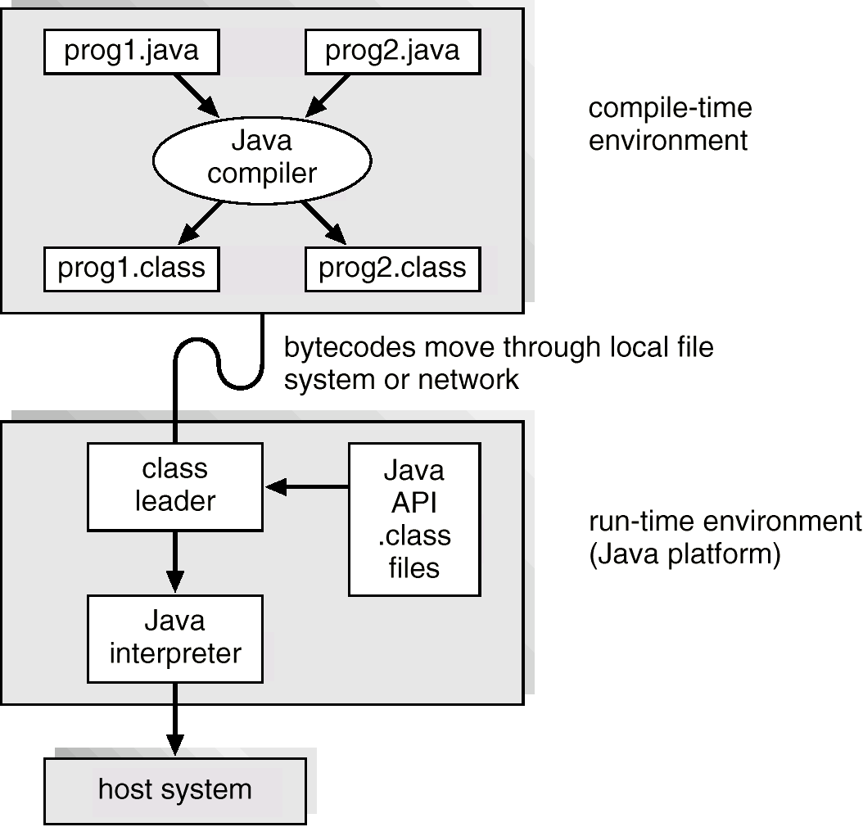
Java Development Environment

Slide 13
Lecture 02: Docker Containers
Server Virtualization
Before Server Virtualization:
After Server Virtualization:
App App App
Operating system
App App App
Operating system
Application
Operating system
Virtualization layer
Virtual Machines (VMs) break dependencies between operating system and hardware
Manage operating system and application as single unit by encapsulating them into VMs
Strong fault and security isolation
Single operating system image per machine
Software and hardware tightly coupled
Running multiple applications on same machine often creates conflict
Underutilized resources

Slide 14
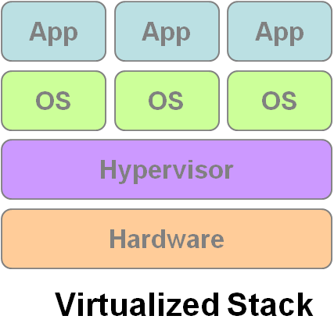
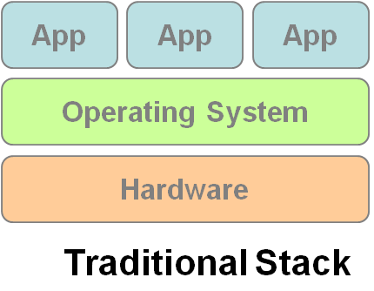
Virtual Machine Monitor
Lecture 02: Docker Containers
What’s Virtual Machine Monitor (VMM) ?
– VMM or Hypervisor is the software layer providing the virtualization.
System architecture :
VM1
VM2
VM3

Slide 15
Virtual machines limitations
Lecture 02: Docker Containers
VMs take up a lot of system resources.
Each VM runs not just a full copy of an operating system, but a virtual copy of all the hardware that the operating system needs to run.
This quickly adds up to a lot of RAM and CPU cycles.

Slide 16
Number of VMs per Host?
Lecture 02: Docker Containers
How much is too much?
500 VMs on one server host is possible but sometimes less is more. Risk, utilization rates and memory factor into the decision.
Virtualization doesn't just consolidate as many servers as possible -- it has to actually do something.

Slide 17

Lecture 02: Docker Containers
Do we have some alternative?
Docker containers wrap up a piece of software in a complete filesystem that contains everything it needs to run: code, runtime, system tools, system libraries – anything you can install on a server. This guarantees that it will always run the same, regardless of the environment it is running in

Slide 18
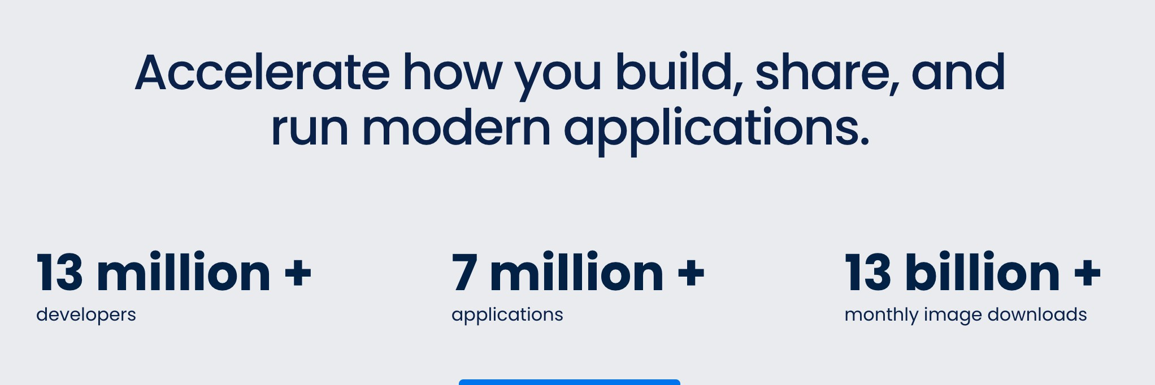
Lecture 02: Docker Containers
Docker on the rise

Slide 19
Docker containers
Lecture 02: Docker Containers
Containers running on a single machine all share the same operating system kernel so they start instantly and make more efficient use of RAM.
You can thus stuff more containers on a server host than VMs.

Slide 20
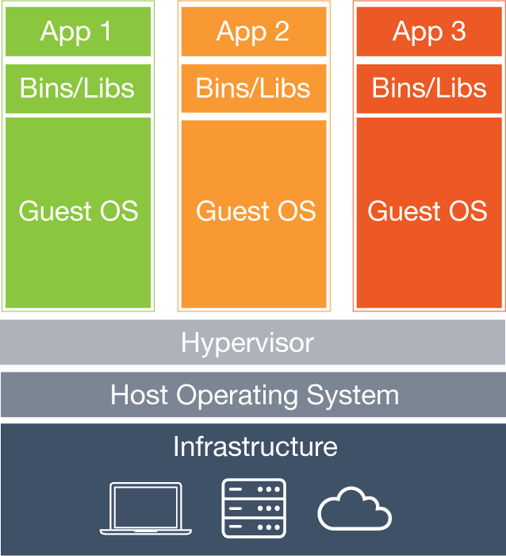
How is this different?
Lecture 02: Docker Containers
Each virtual machine includes the application, the necessary binaries and libraries and an entire guest operating system - all of which may be tens of GBs in size.

Slide 21
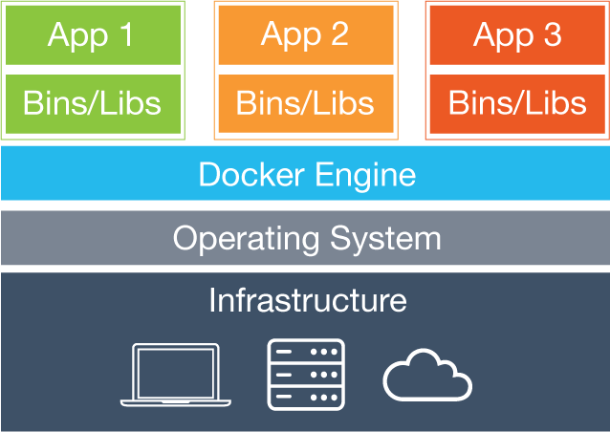
How is this different?
Lecture 02: Docker Containers
Containers include the application and all of its dependencies, but share the kernel with other containers. They run as an isolated process in userspace on the host operating system.

Slide 22
Lecture 02: Docker Containers
Installation
The getting started guide on Docker has detailed instructions for setting up Docker on Mac, Linux and Windows
On Mac/Windows - Two variants, Native and Toolbox

Slide 23
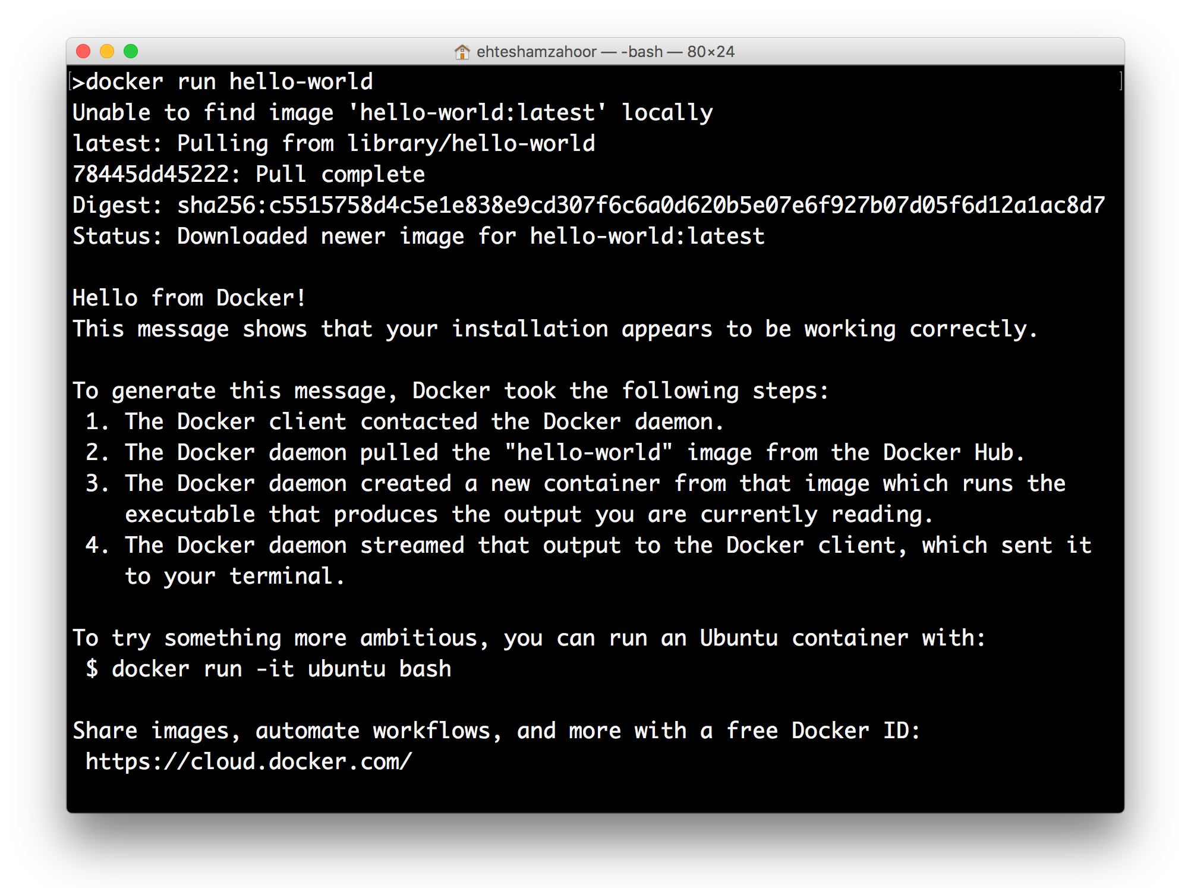
Lecture 02: Docker Containers

Slide 24
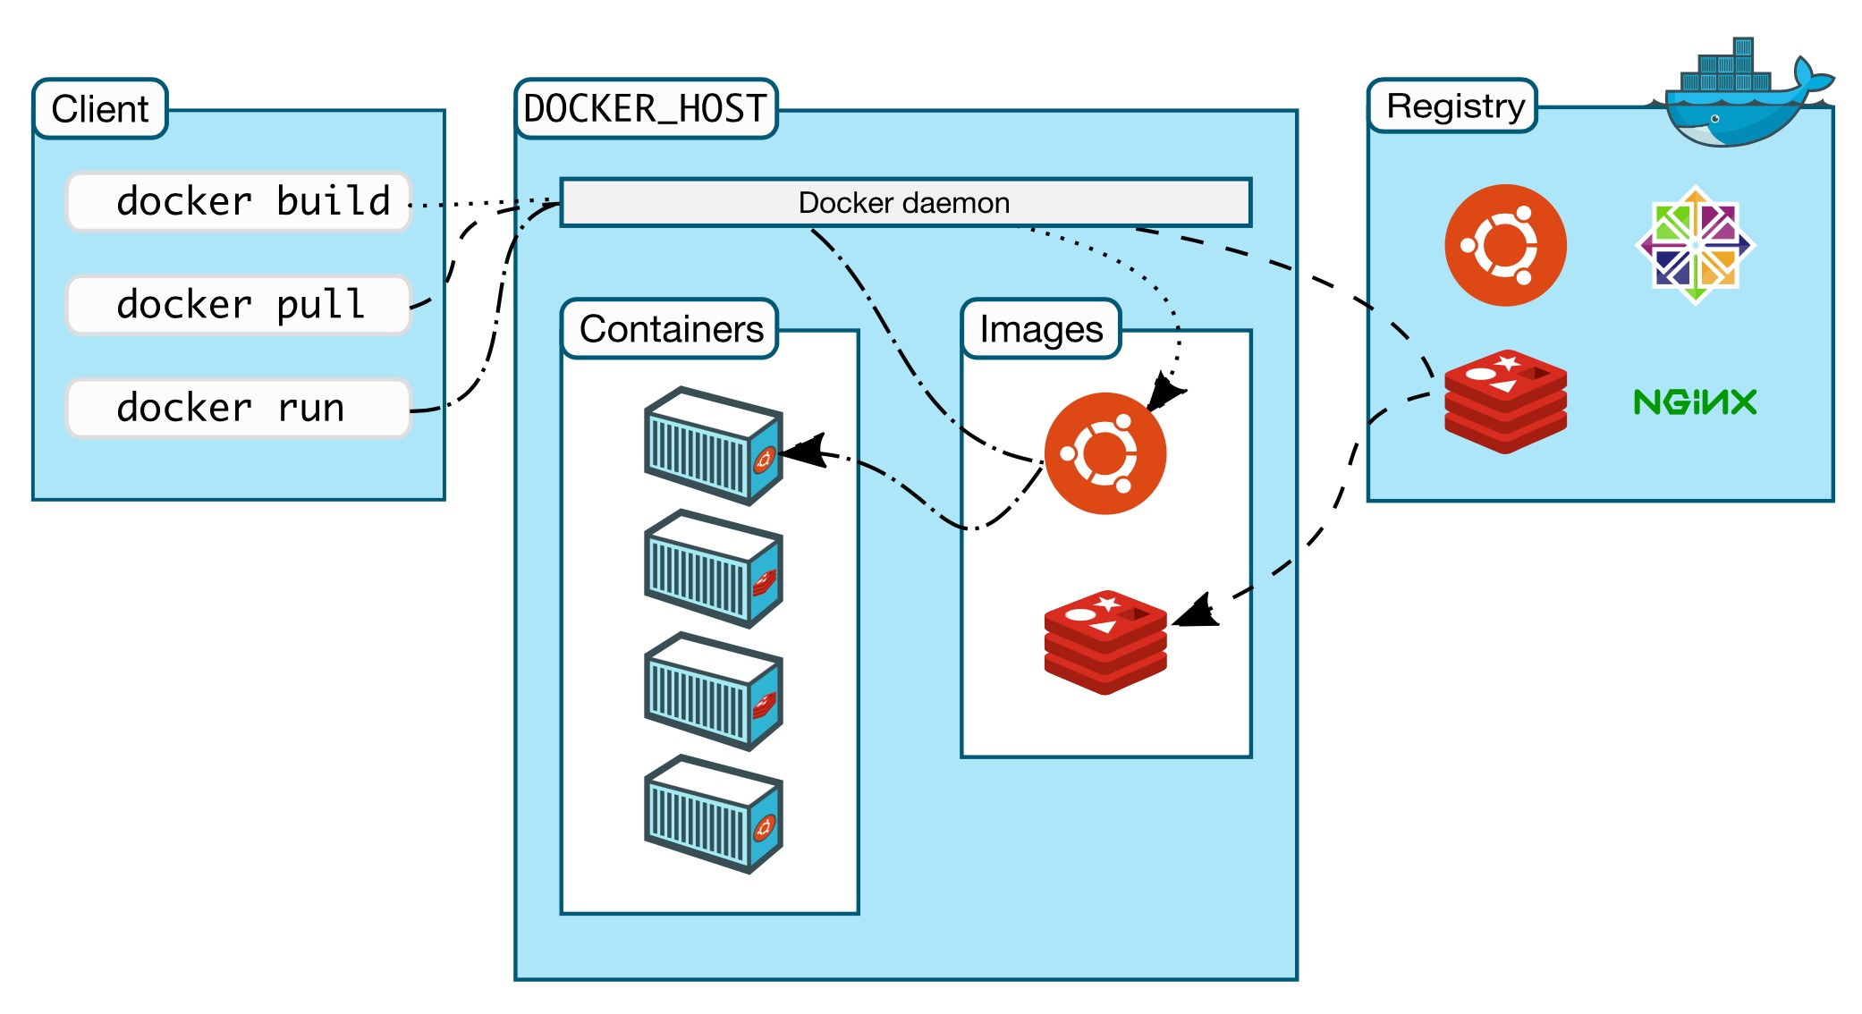
Lecture 02: Docker Containers
Docker’s architecture

Slide 25
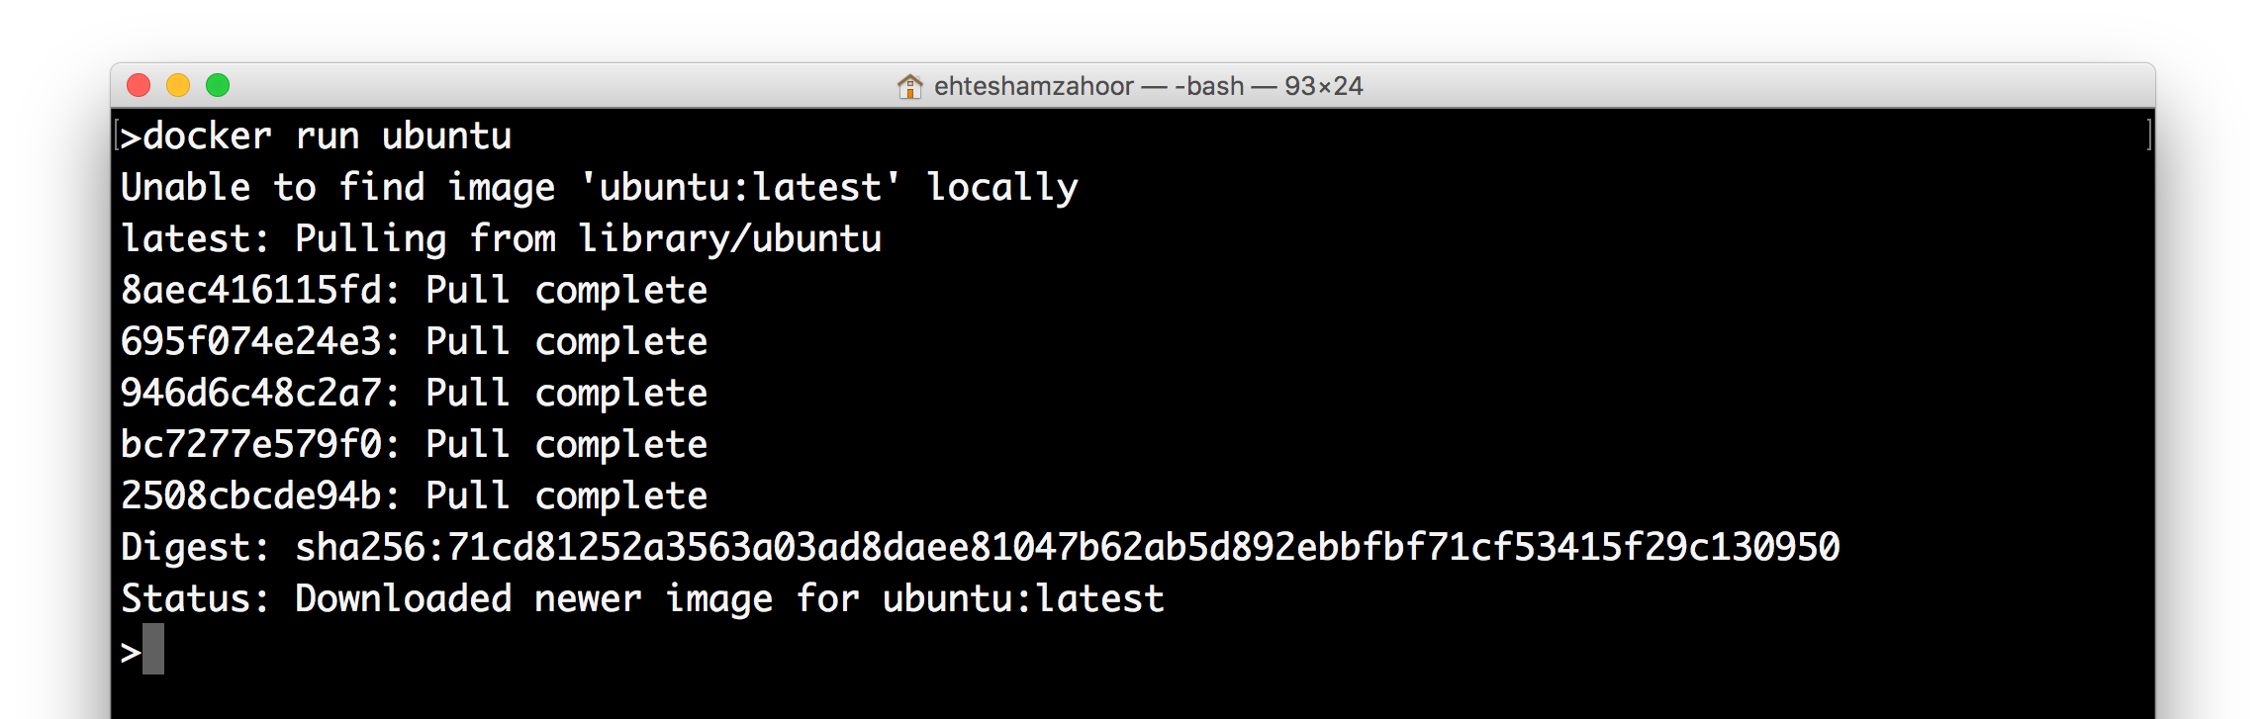
Lecture 02: Docker Containers

Slide 26
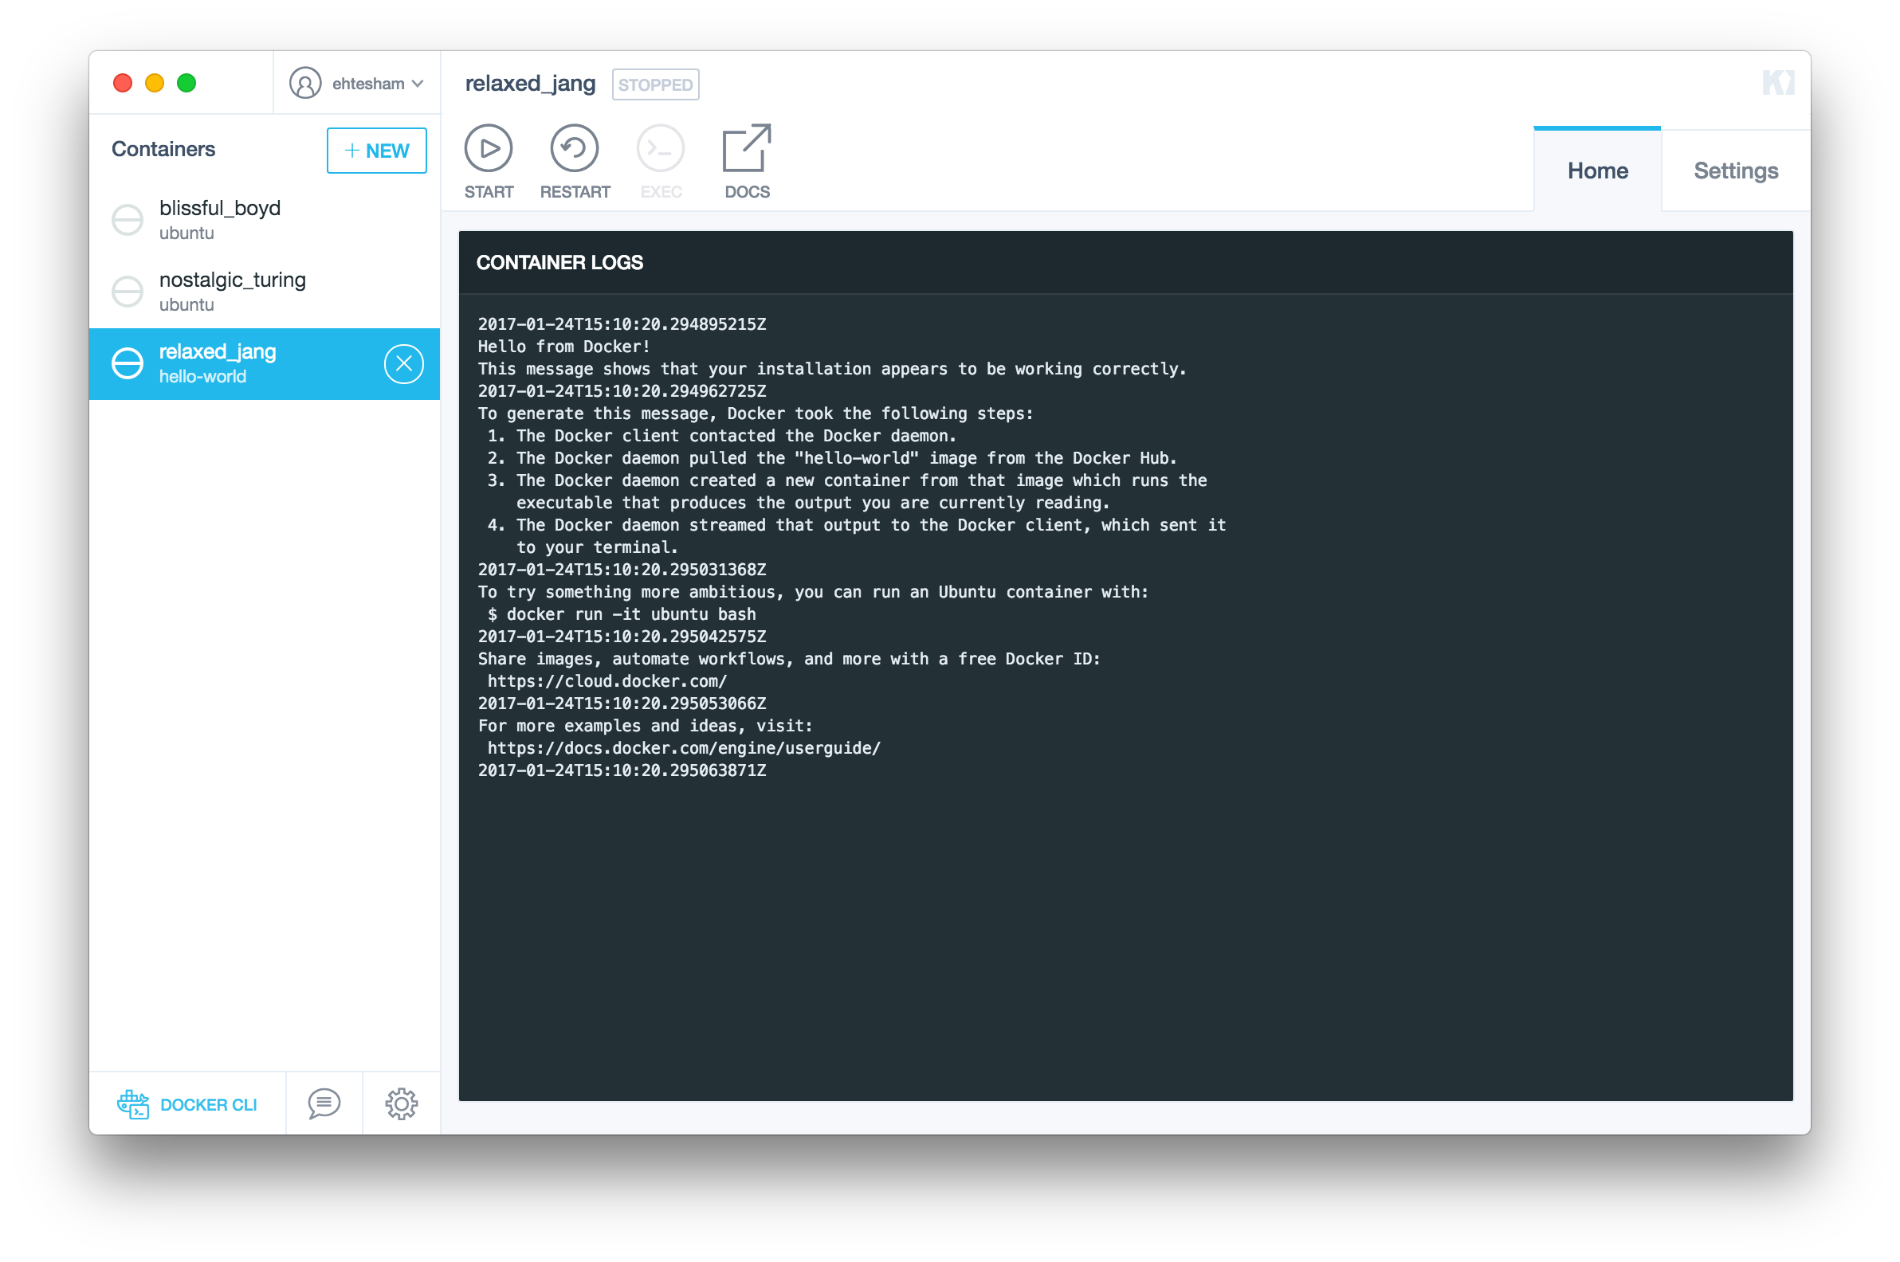
Lecture 02: Docker Containers

Slide 27
Deploying Webapp with docker
Lecture 02: Docker Containers
Let us deploy a static one page Website with docker.
We create a simple Web page in a directory,
/Users/ehteshamzahoor/docker/staticweb, lets name it index.html

Slide 28
Deploying Webapp with docker
Lecture 02: Docker Containers
In the same directory we create a file named Dockerfile with following contents
FROM nginx:alpine
COPY . /usr/share/nginx/html

Slide 29
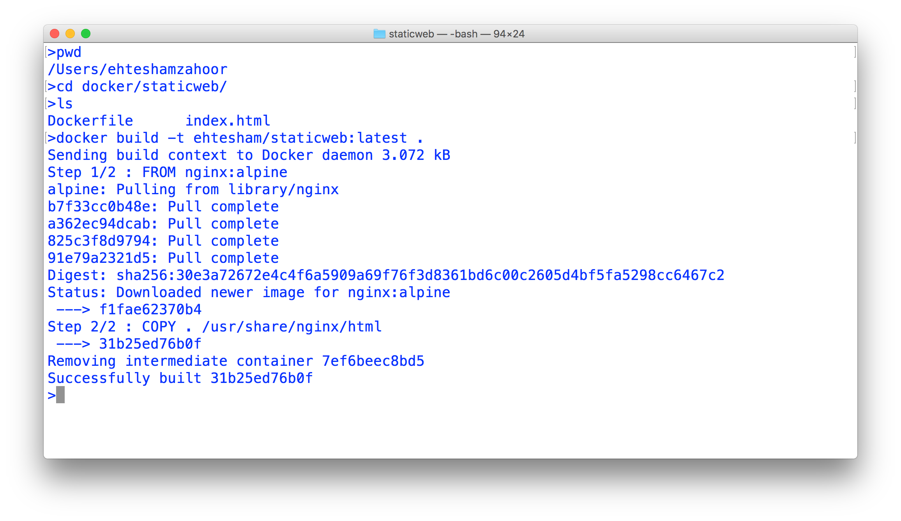
Lecture 02: Docker Containers
Deploying Webapp with docker

Slide 30
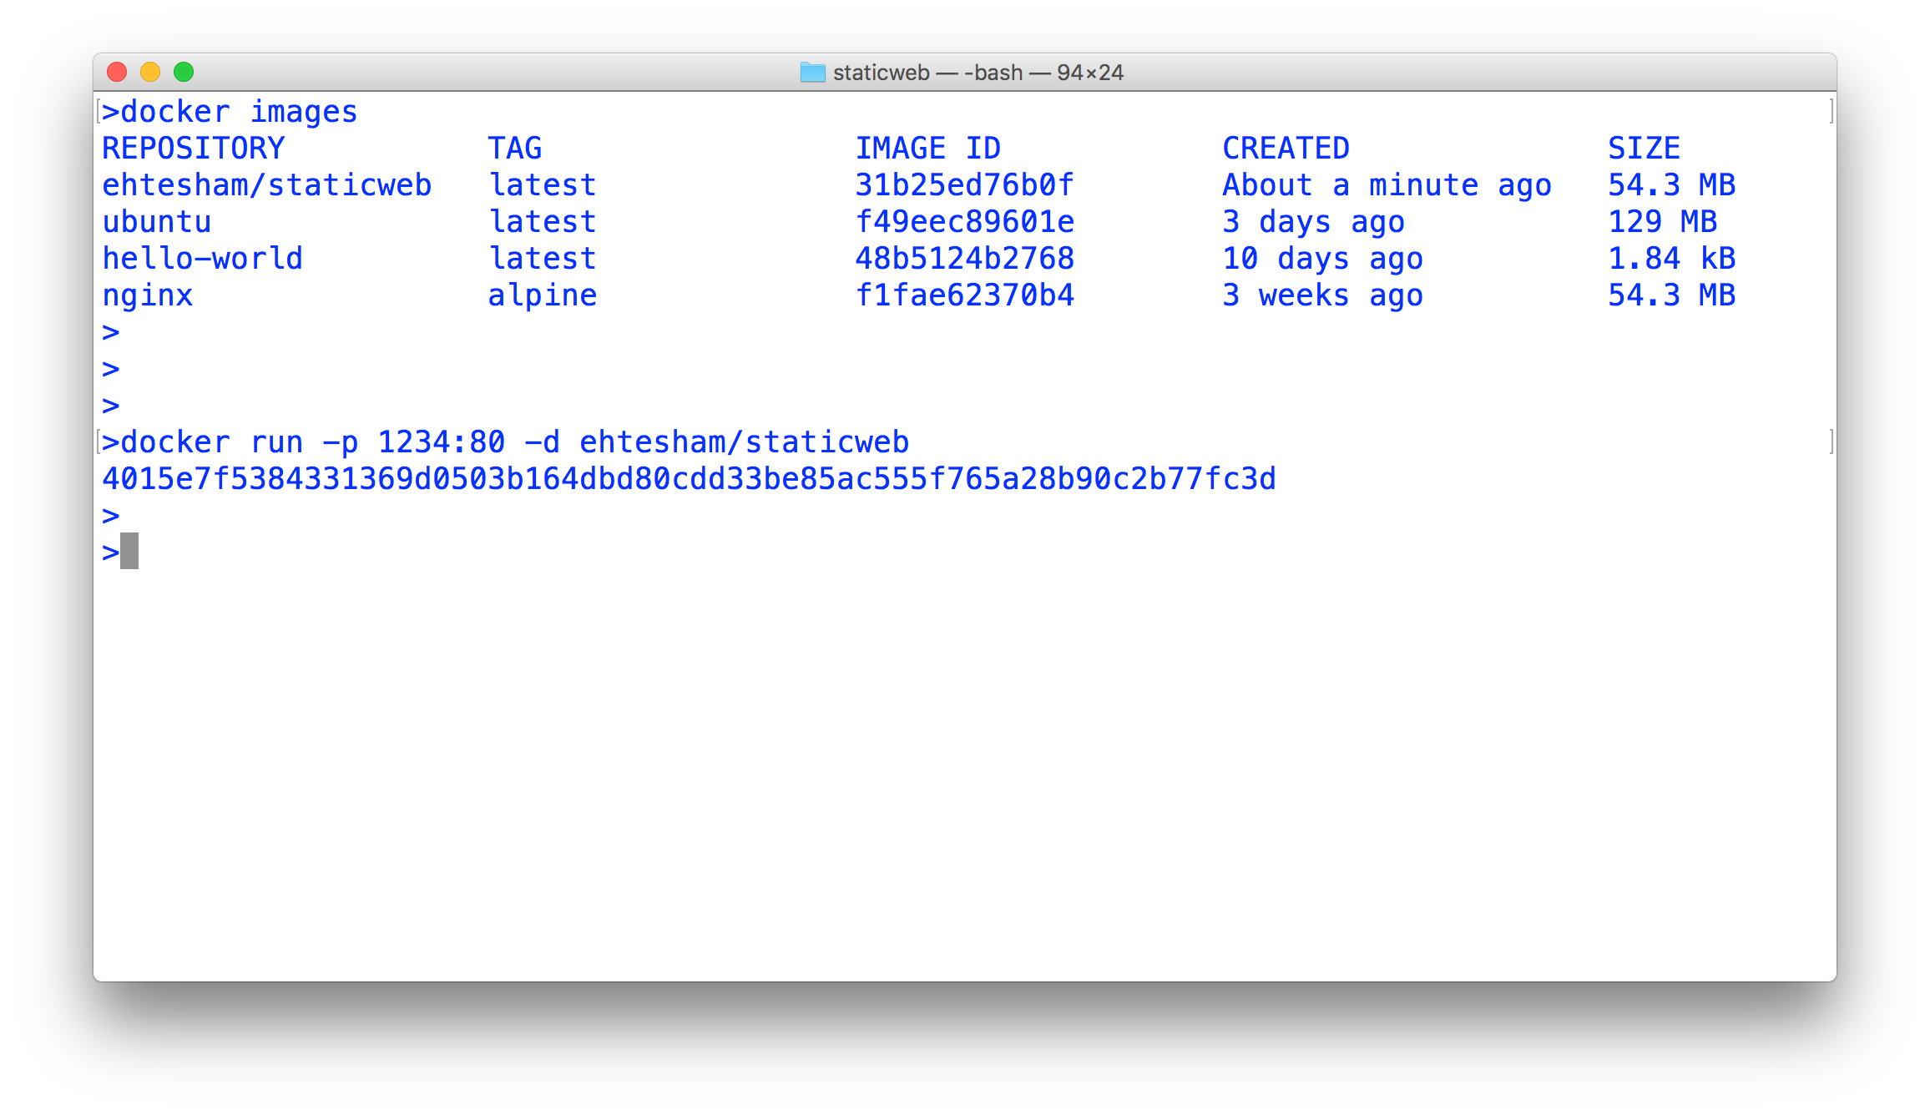
Lecture 02: Docker Containers
Deploying Webapp with docker

Slide 31
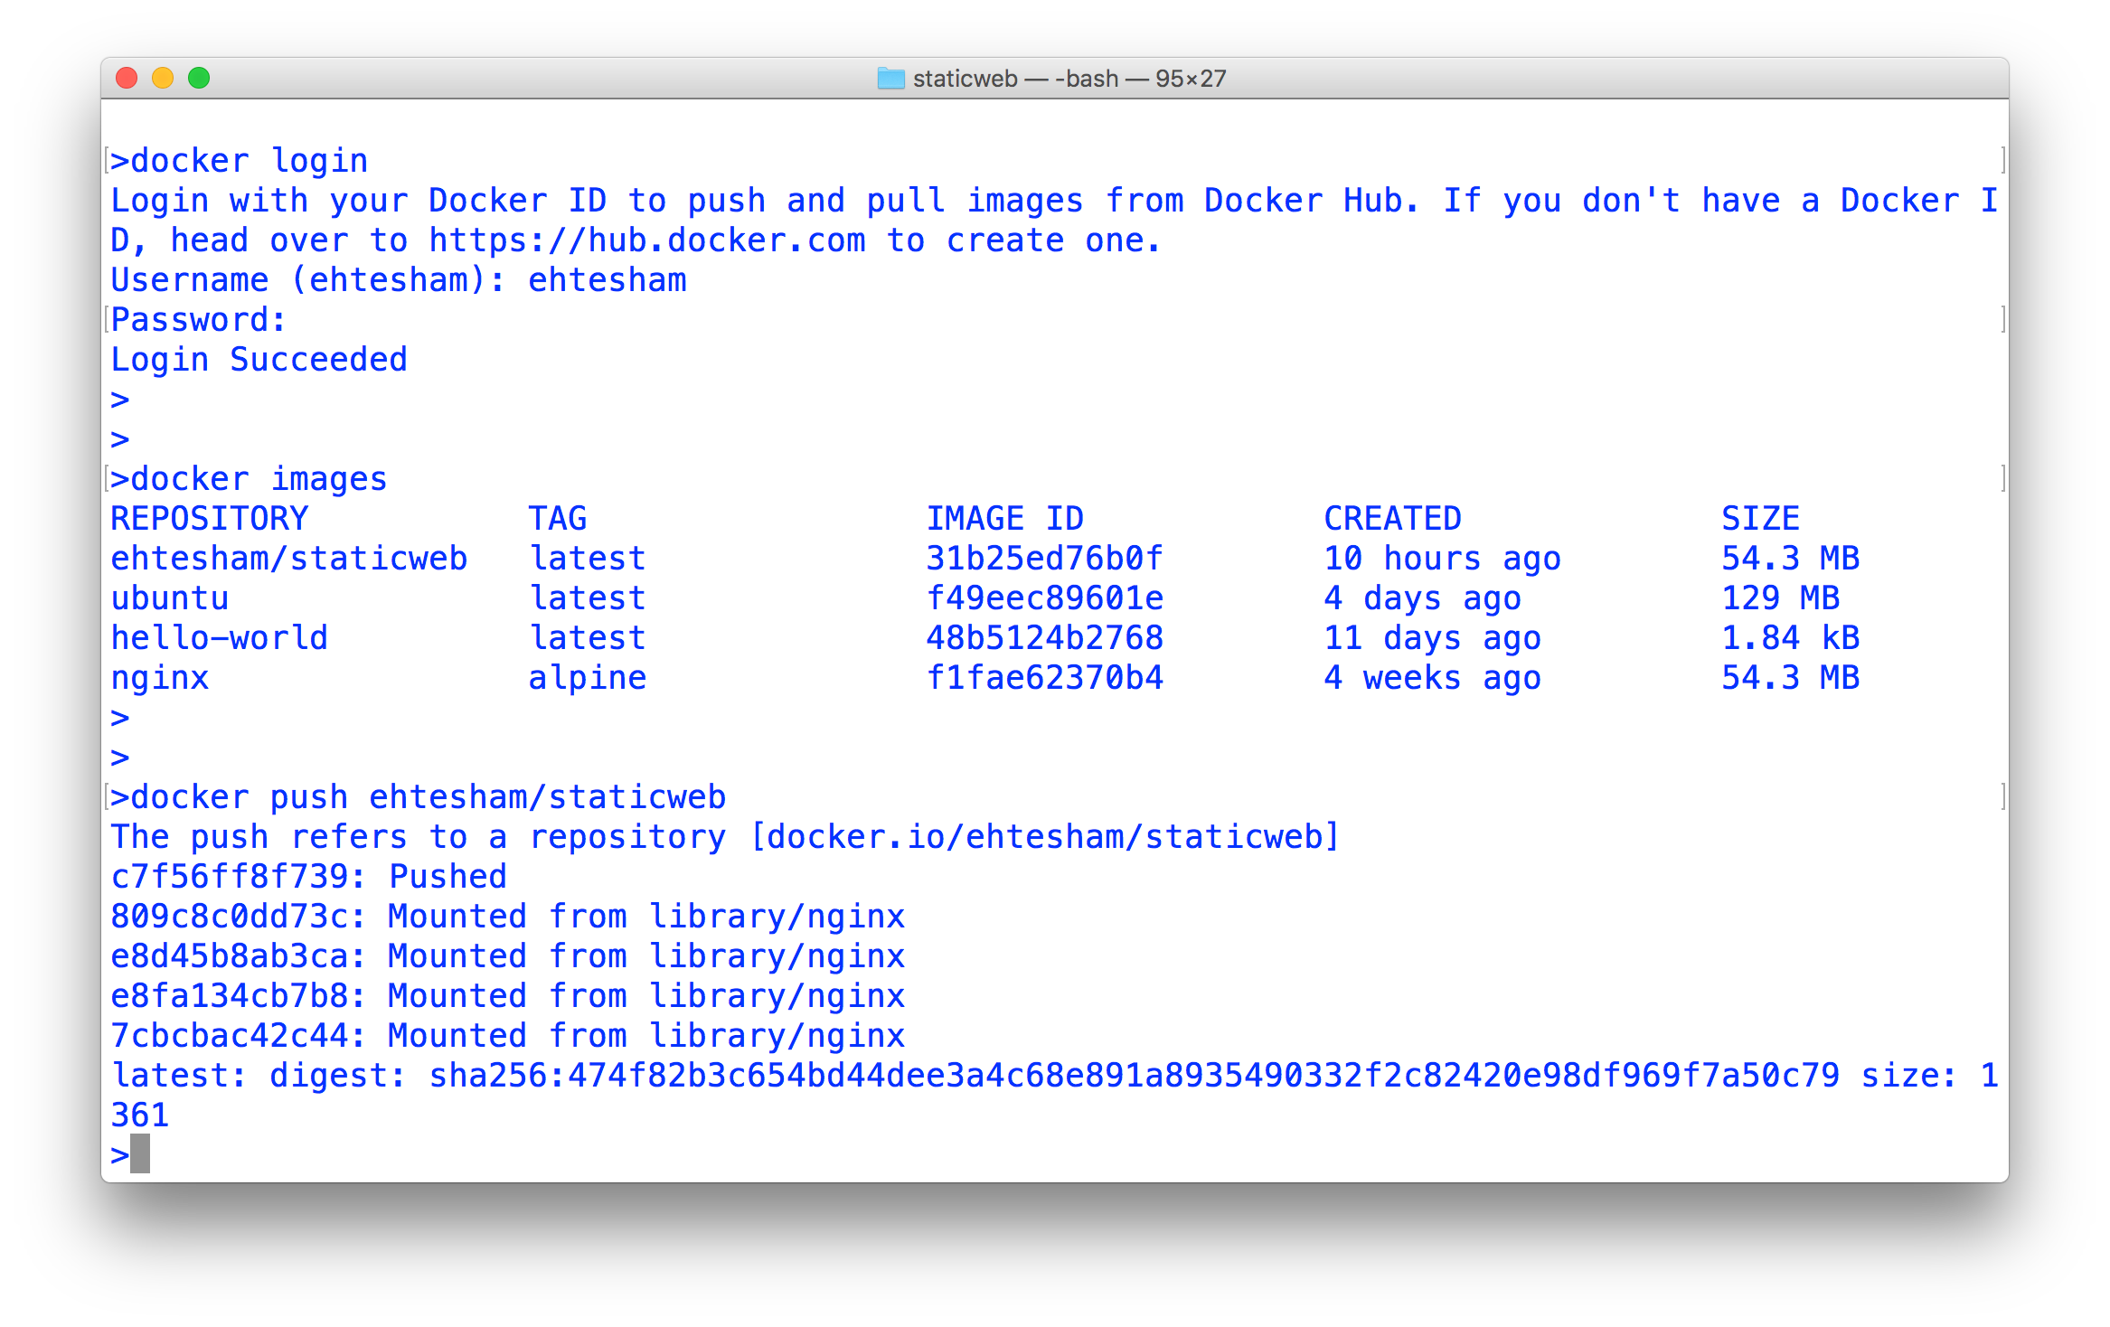
Lecture 02: Docker Containers
Deploying Webapp with docker

Slide 32
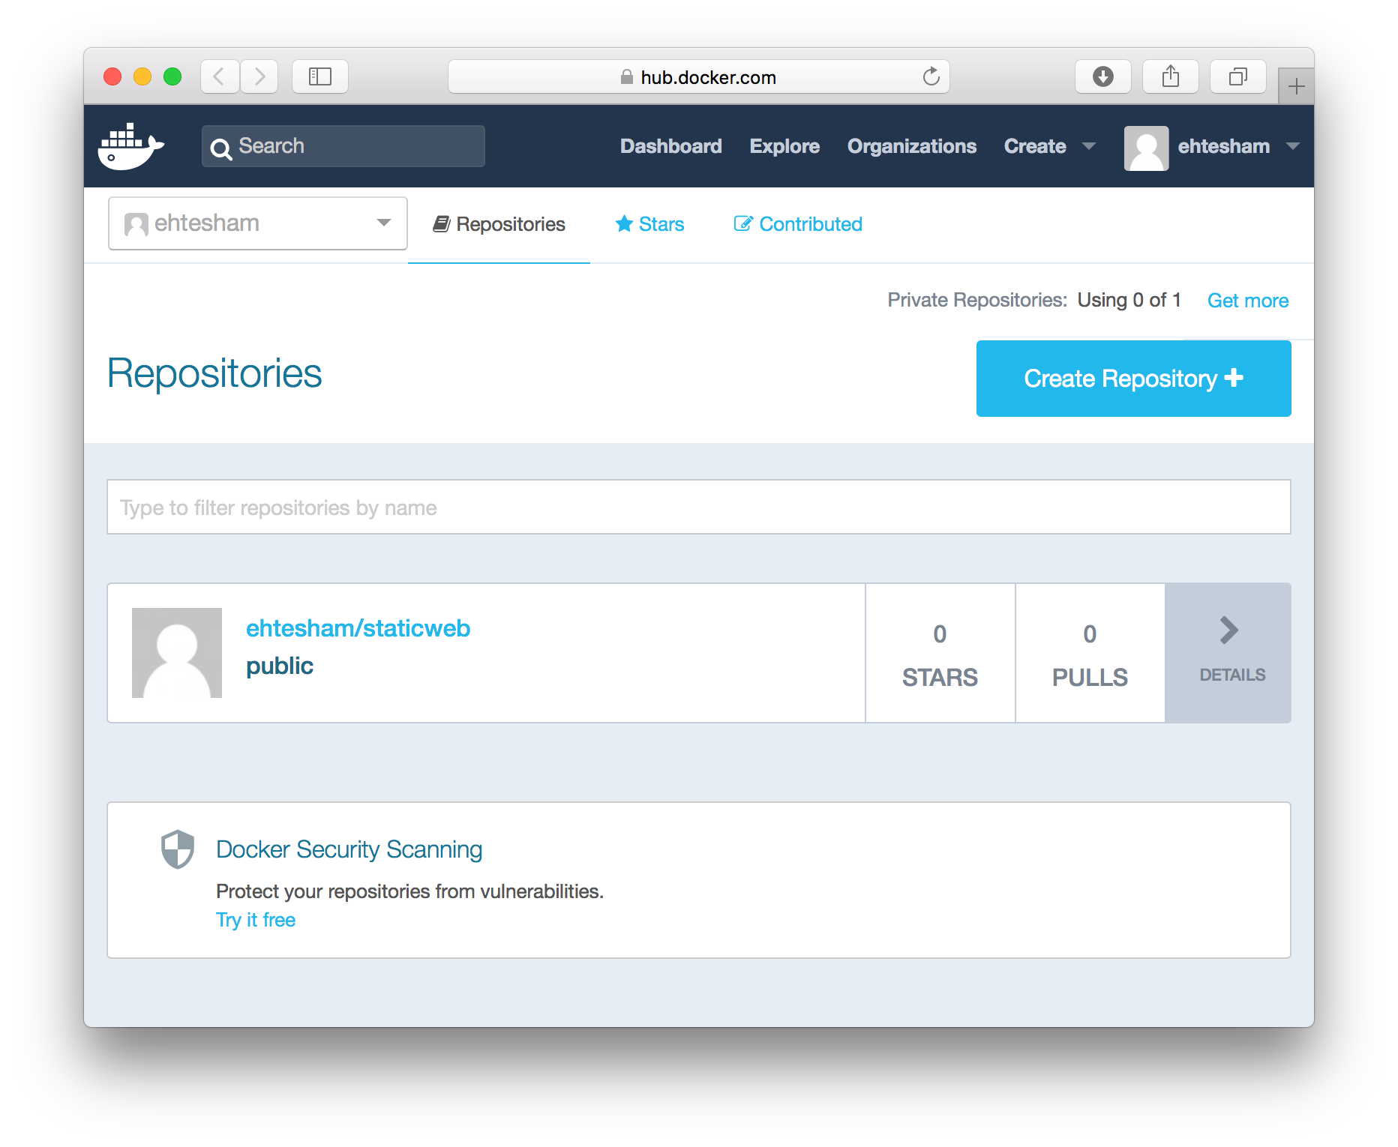
Lecture 02: Docker Containers
Deploying Webapp with docker

Slide 33
Deploying Webapp with docker
Lecture 02: Docker Containers
We can use AWS BeansTalk to make our WebApp public !!

Slide 34
Running helloAOS – on Docker
Lecture 02: Docker Containers
#include <iostream> using namespace std;
int main()
{
cout << "Hello AOS \n"; return 0;
}

Slide 35
Dockerfile
Lecture 02: Docker Containers
FROM gcc:4.9
RUN mkdir -p /app COPY . /app WORKDIR /app
RUN g++ helloaos.cpp -o hello RUN chmod +x hello
CMD ["./hello"]

